Slide 1

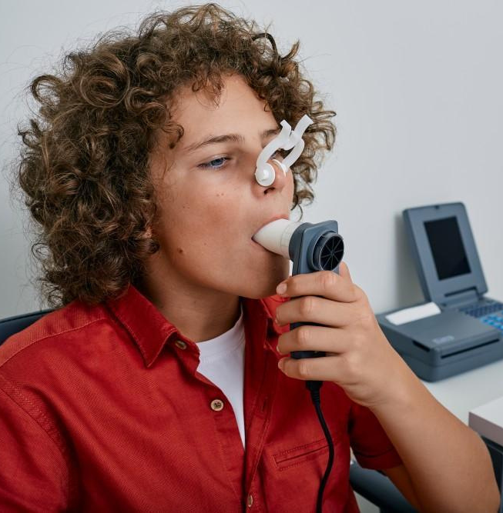
Establishing a Comprehensive and dynamic COPD Database
Final Project
Biomedical Engineering
Noa Diskin & Daniel Hagendorf
Supervisor:
Dr. Doron Schwarts Cohn

Slide 2
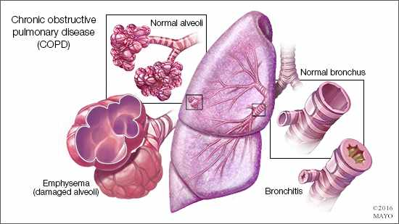
COPD- Introduction
3rd leading cause of death globally
Symptoms: dyspnea, cough, sputum
Diagnosis relies on spirometry:
FEV1/FVC < 0.7 [%]
Phenotypic diversity
complicates diagnosis
Notes:
Chronic Obstructive Pulmonary Disease (COPD) is the 3rd leading cause of death globally. COPD remains a major global health concern, with over 300 million individuals affected worldwide, significantly contributing to morbidity, mortality, and healthcare costs.
The primary risk factors include tobacco smoking, air pollution, and occupational exposures.
COPD manifests primarily as either obstructive or restrictive pathologies:
resulting with abnormalities in the airways and alveoli- leading to progressive airflow obstruction.
Diagnosis is based on spirometry, which demonstrates fixed airway obstruction. This is assessed by dividing the Forced Expiratory Volume during the 1st second of exhalation (FEV1) by the Forced Vital Capacity (FVC). A FEV1/FVC ratio below 0.7 is typically diagnostic of COPD.

Slide 3
Current
Research Gap
Under/Overdiagnosis is widespread
Spirometry is underutilized in clinics
No validated database for COPD phenotypes
Need for standardized, automated tool
Notes:
Spirometry is underutilized in many clinical settings, contributing to significant issues of underdiagnosis and overdiagnosis.
For example, patients are sometimes grouped based on clinical diagnosis alone, which can lead to inaccuracies. Studies show that up to 26% of symptomatic individuals with spirometric evidence of COPD remain undiagnosed, while 25–50% of patients clinically labelled with COPD lack objective confirmation.
Current diagnostic practices are hindered by the underutilization of spirometry and the absence of robust, clinically validated databases.

Slide 4
Motivation
Project Objectives
Develope a fast, reliable and automated system for spirometry data extraction
Establish a validated, dynamic COPD database
Enable ML/DL analytics for Future research
Notes:
This project aims to create an automated system for extracting key parameters from spirometry tests, ensuring diagnostic accuracy, and facilitating real-time data integration into a dynamic, continuously expanding database.
This database will serve as a cornerstone for advanced analytical studies, enabling the classification of new and existing COPD cases. Furthermore, it will leverage machine learning (ML) and deep learning (DL) algorithms to uncover novel clinical insights and improve patient stratification for therapeutic interventions.
By addressing the limitations of current diagnostic practices and establishing a validated resource for COPD data, this project seeks to enhance early detection, reduce misdiagnosis, and provide a foundation for innovative clinical research.

Slide 5
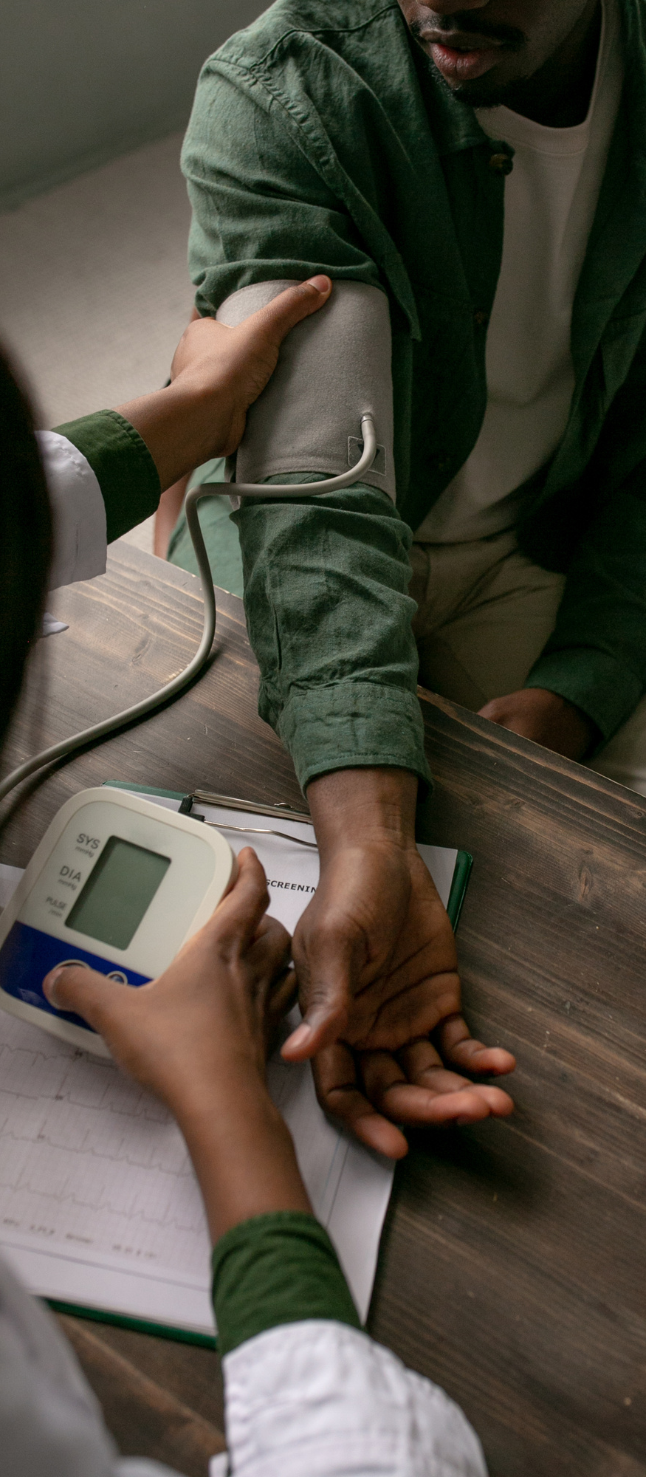

Methods
Data Extraction
Extracts spirometry data from PDF files with python
Handles variations in report formats
OCR (Tesseract / easyocr) with image pre-processing steps (opencv)
Dynamically find the best black and white threshold
Regex patterns identify key measurements

Slide 6
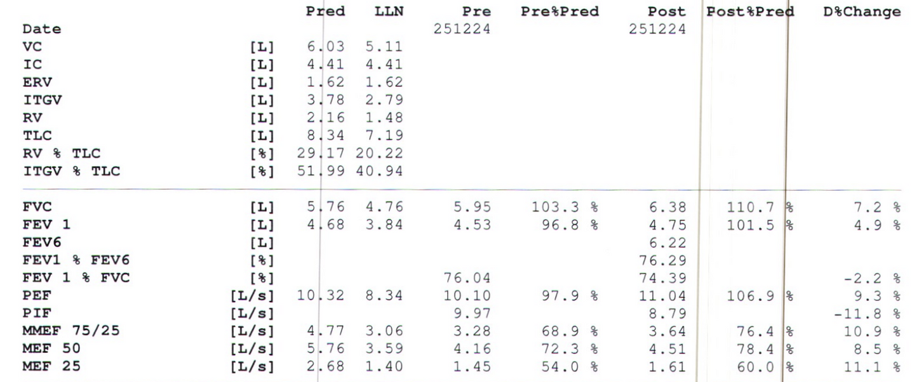
Methods
Validation
Handles rounding errors and missing decimals
Outputs errors and fixed values for accuracy
Supports various input formats
Validates numerical logic between measurements
Notes:
DANIEL

Slide 7
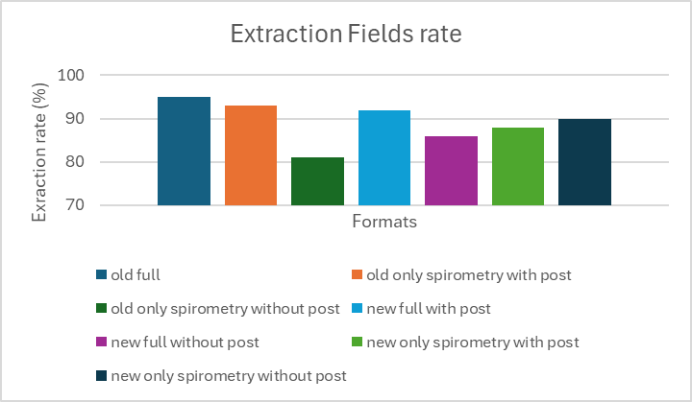
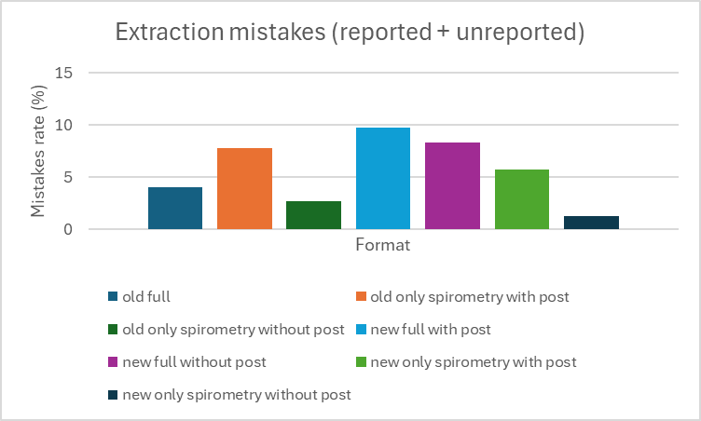
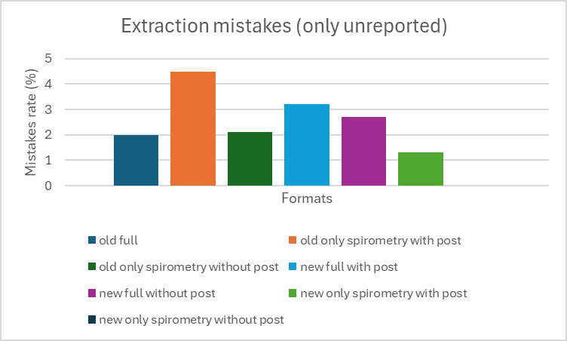
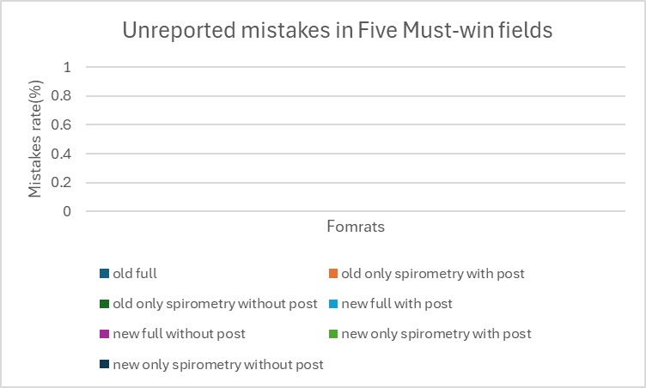
Preliminary Results
Notes:
field extraction plot: change label "extraction" to "accuracy" rate.

Slide 8
Disscusion: Current obstacles
  Helsinki’s approval
  Authorization & Security
  Computing power
  OCR improvements
Notes:
Helsinki Approval:
Ethical approval required to work with real clinical spirometry data.
Computing Power:
Heavy image processing (OCR) and large database management demand strong servers or cloud resources.
OCR Accuracy Challenges:
Variations in PDF formats and scan quality affect text recognition reliability; ongoing optimization needed.
Authorization & Security:
Handling sensitive medical data demands strict security, encryption, and user authentication measures.

Slide 9

Future Development:
The Next Steps
FRONTEND DEVELOPMENT FOR DATA VISUALIZATION
DOCUMENTATION FOR IT REVIEW
PILOT DEPLOYMENT ON TEST MACHINE
INTEGRATION INTO CLINICAL WORKFLOWS

Slide 10
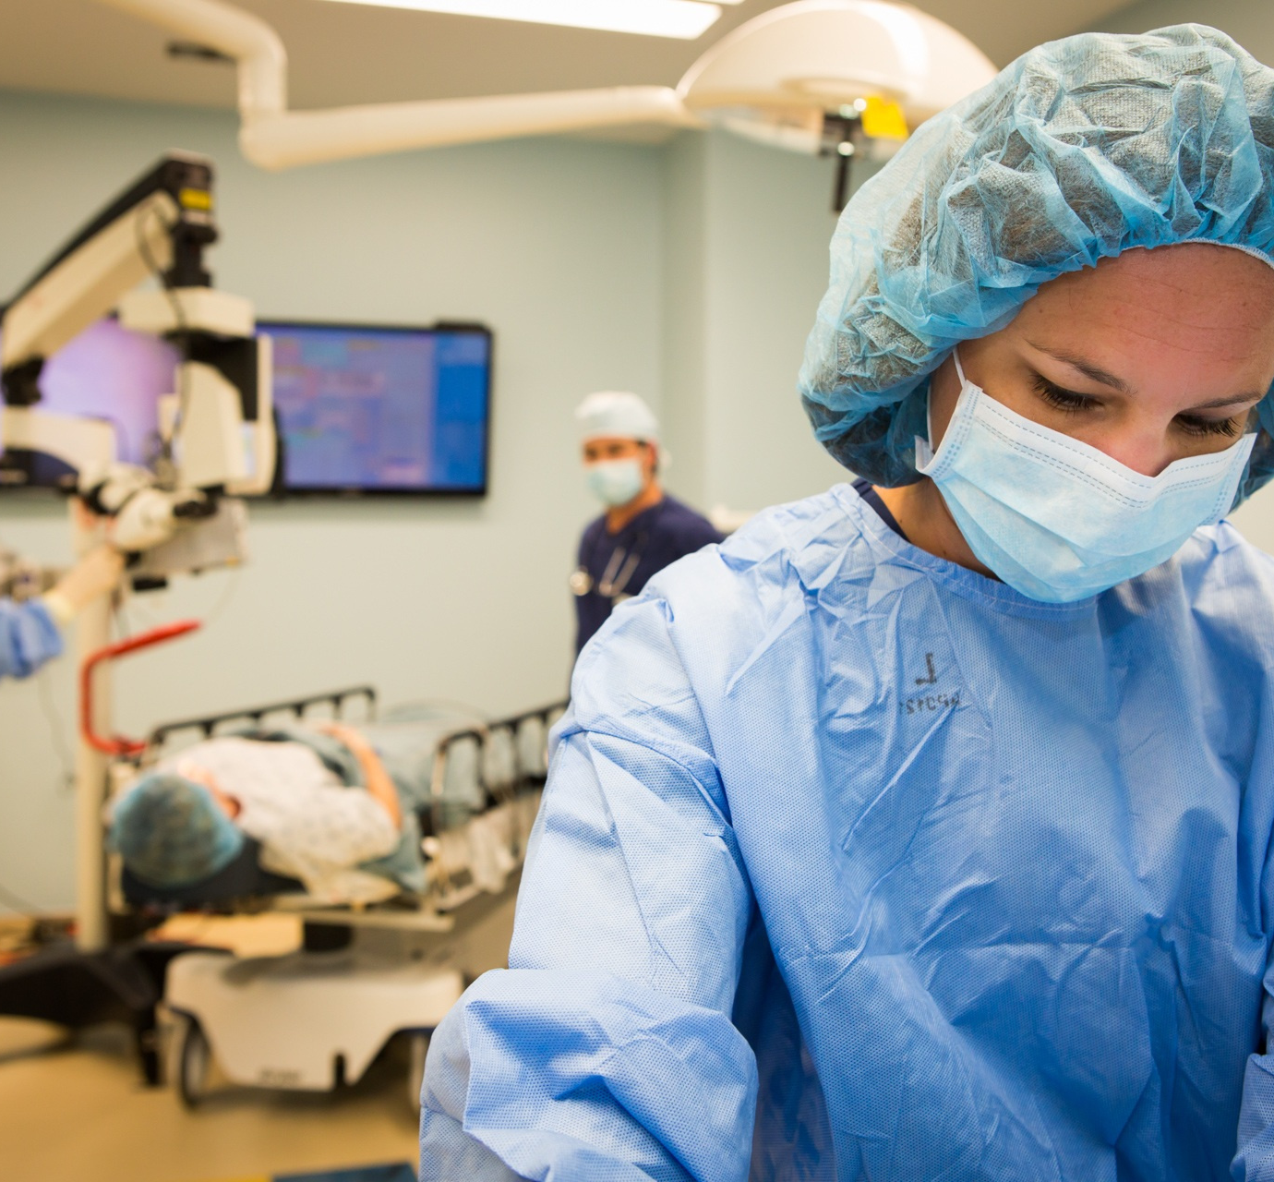
Any questions?
Thank You!

